Slide 1

Application Project:
Dangerous good classification for the LHG
Torsten Brockhaus
Damilare Osunleke
Aleksei Trikoz

Slide 2
l. Contents
The task
Dangerous goods labels
Sample
The model
Recommendations and next steps

Slide 3
The task:
Train a ML solution to classify dangerous goods labels on trucks and deploy it in a Docker container.

Slide 4

Dangerous goods labels

Slide 5
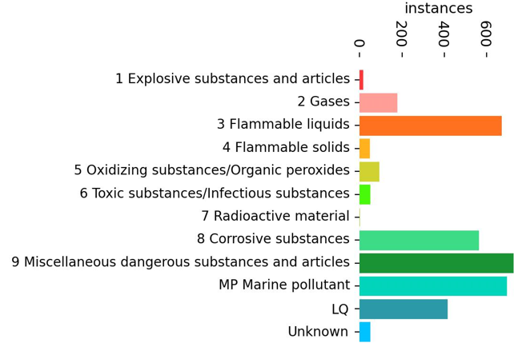
The data
Sample
Out of 70,000 images, 2.470 images have at least one sign
Sample is heavily unbalanced
Consists of images of different times of day with different lighting

Slide 6
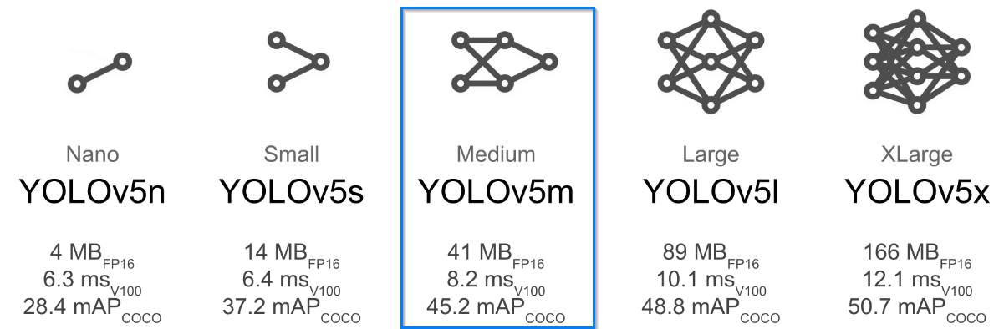
The model
YOLOv5m
Our choice – Medium size model
291 layers
20.915.769 parameters
a good compromise between the speed and accuracy

Slide 7
The model
Training
Of the 2,470 images, 2,270 were used for training and 200 for testing
265 images without sings were added to reduce false positives
Image size (resolution) – 640. (Also, possible train at 1280 resolution).
Train and test pictures resolutions should be the same for better accuracy
Due to the lack of powerful hardware, the training was performed on Google Colab
For 100 epochs in 16 batches, the total runtime in Google Colab was about 3.5 hours.

Slide 8
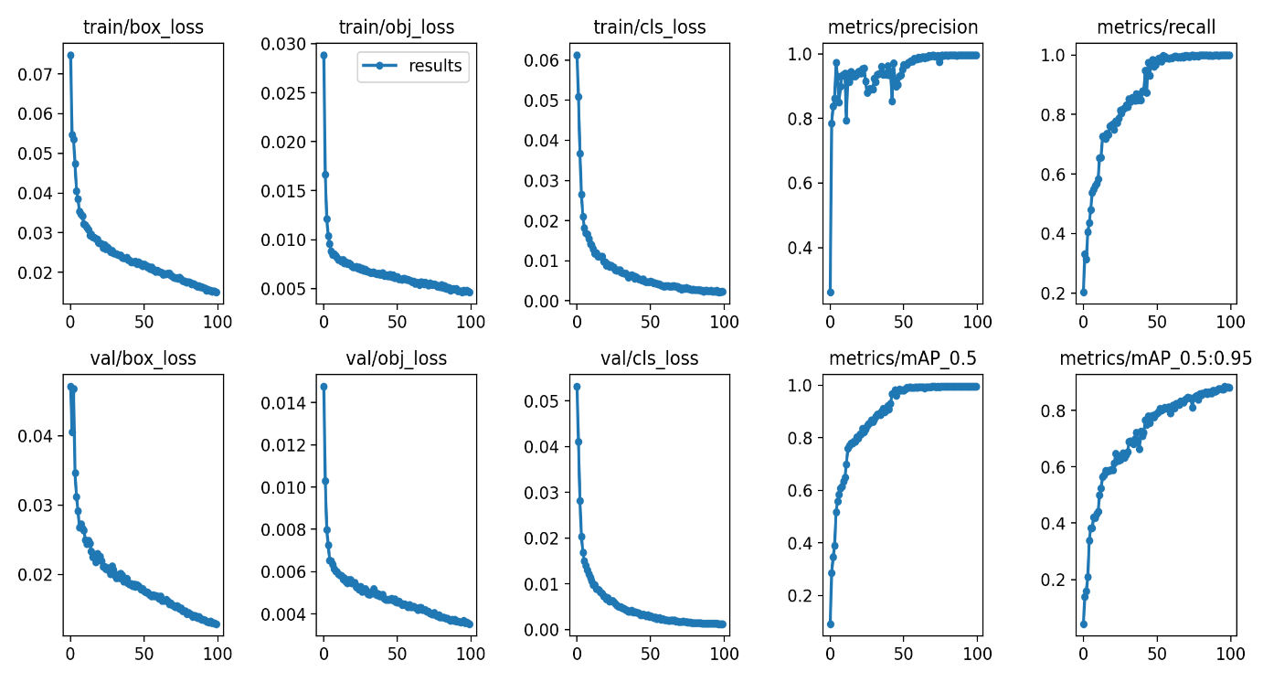
The model
Training results
mAP_0.5 = 0.9946
mAP_0.95 = 0.8817
Increasing the epochs to 200 did not significantly improve the model's performance.

Slide 9
The model
Test results
Class | Instances | Precision | Recall | mAP50 | mAP50-95
all | 135 | 0.902 | 0.915 | 0.951 | 0.793
2 Gases | 8 | 0.807 | 0.75 | 0.781 | 0.723
3 Flammable liquids | 23 | 0.876 | 1 | 0.976 | 0.782
5 Oxidizing substances | 5 | 0.962 | 1 | 0.995 | 0.906
6 Toxic substances | 3 | 1 | 0.778 | 0.995 | 0.764
8 Corrosive substances | 19 | 0.896 | 0.905 | 0.964 | 0.771
9 Miscellaneous dangerous | 28 | 0.923 | 1 | 0.988 | 0.815
MP Marine pollutant | 31 | 0.935 | 1 | 0.995 | 0.844
LQ | 18 | 0.82 | 0.889 | 0.917 | 0.741

Slide 10
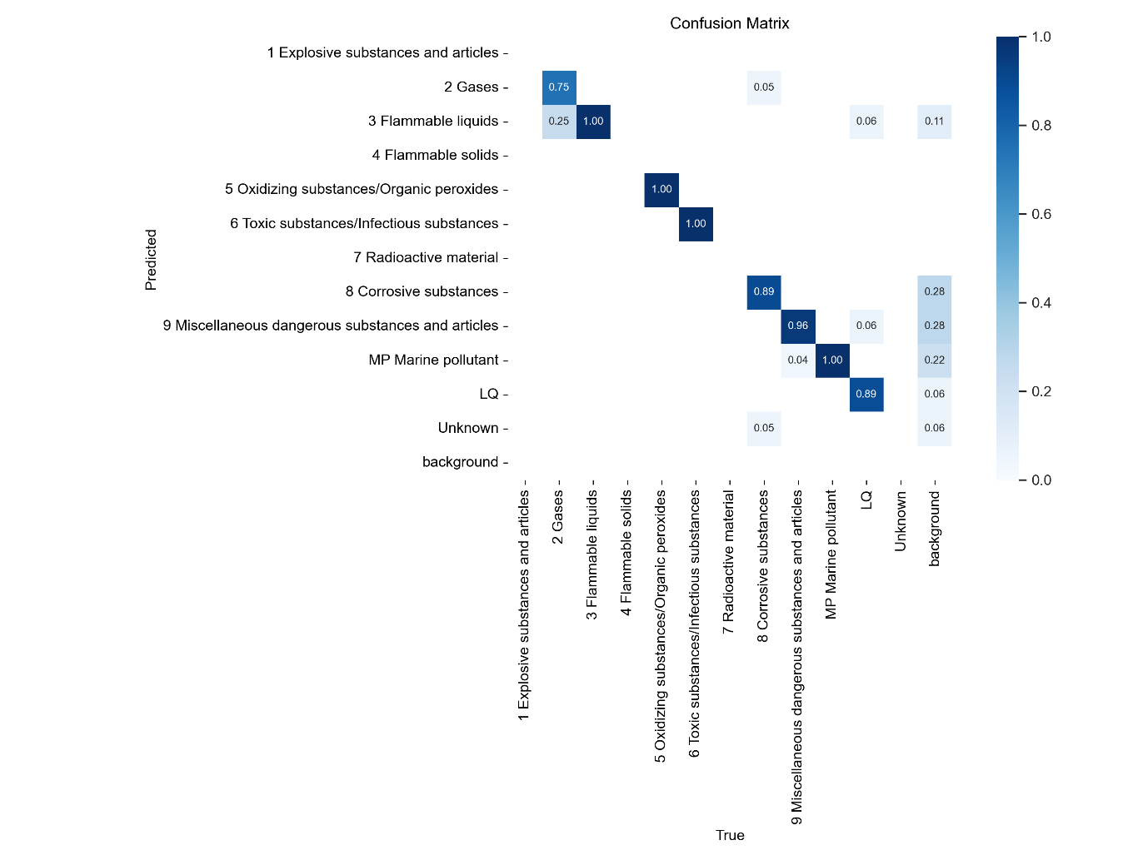
The model
Test results

Slide 11
Recommendations and next steps
The recommendations below are based on the outcome of the project:
Adopt this model for identifying dangerous goods labels on trucks.
In the meantime, perform second-level checks when label 2 is detected. This is due to relatively low recall for that class and its misidentification as label 3.
Retrain the model, but split label 2 into its constituent sub-labels before training
Integrate the model with the existing booking data from the LHG logistics system for auto verification

Slide 12
Image sources
(1)https://www.fh-kiel.de/typo3conf/ext/fh_kiel/Resources/Public/Images/News/fachhhochschule-kiel-campus-ecke.jpg
(2) https://www.lubbers.net/wp-content/uploads/2022/06/ADR.png

Slide 13
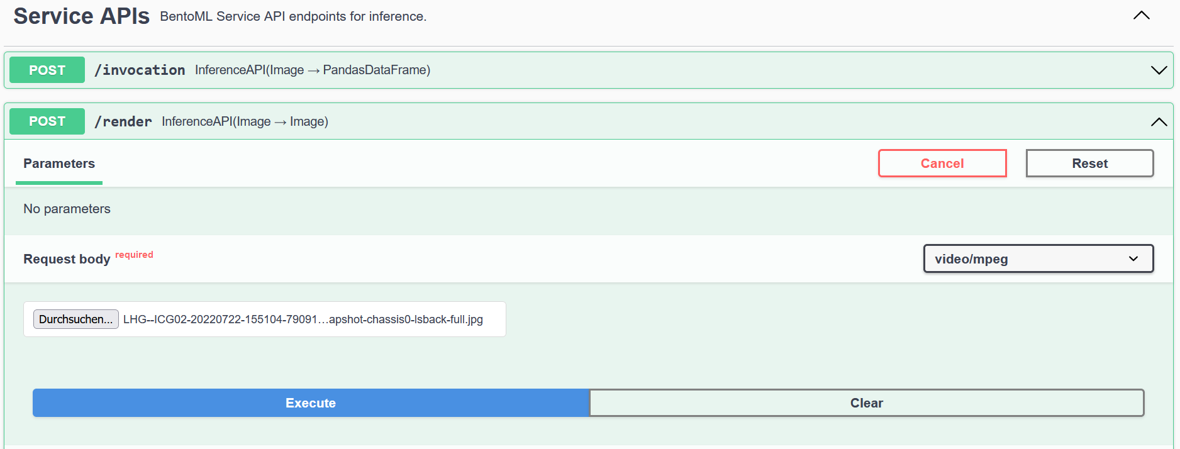
Backup
Service APIs

